Slide 1
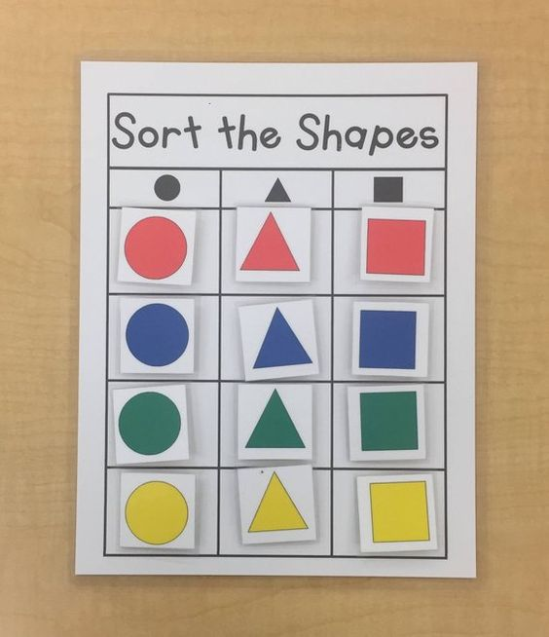
Clustering
Dr Ellis Patrick
School of Mathematics and Statistics, Usyd
The Westmead Institute for Medical Research

Slide 2
Bioinformatics
As an interdisciplinary field of science, bioinformatics combines biology, computer science, information engineering, mathematics and statistics to analyze and interpret biological data.
– “Wikipedia”

Slide 3
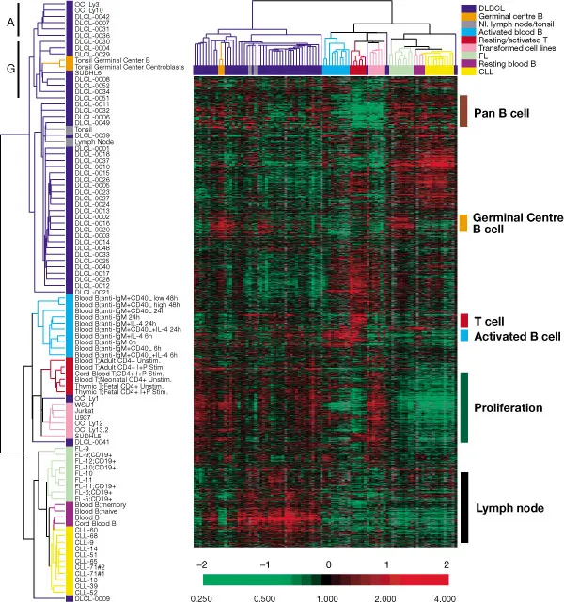
Clustering 20,000 genes
Alizadeh, Ash A., et al. "Distinct types of diffuse large B-cell lymphoma identified by gene expression profiling." Nature 403.6769 (2000): 503.

Slide 4
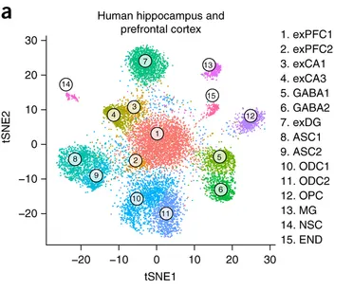
Clustering 100,000 cells
Habib, Naomi, et al. "Massively parallel single-nucleus RNA-seq with DroNc-seq." Nature methods 14.10 (2017): 955.

Slide 5
Breast cancer
130 patients. Consider 10 variables:
node.positive hormonal.therapy chemotherapy.treatment
age.at.diagnosis Ethnicity tumor.size..mm
TumorGrading radiation.treatment Progesterone.Receptor.status
EstrogenReceptorStatus
Genomic and transcriptional aberrations linked to breast cancer pathophysiologies. (PMID:17157792)

Slide 6
Breast cancer
130 patients. Consider 10 variables:
node.positive hormonal.therapy chemotherapy.treatment
age.at.diagnosis Ethnicity tumor.size..mm
TumorGrading radiation.treatment Progesterone.Receptor.status
EstrogenReceptorStatus
Genomic and transcriptional aberrations linked to breast cancer pathophysiologies. (PMID:17157792)

Slide 7
Breast cancer
130 patients. Consider 10 variables:
node.positive hormonal.therapy chemotherapy.treatment
age.at.diagnosis Ethnicity tumor.size..mm
TumorGrading radiation.treatment Progesterone.Receptor.status
EstrogenReceptorStatus
Genomic and transcriptional aberrations linked to breast cancer pathophysiologies. (PMID:17157792)

Slide 8
Unsupervised clustering

Slide 9
K-means clustering

Slide 10
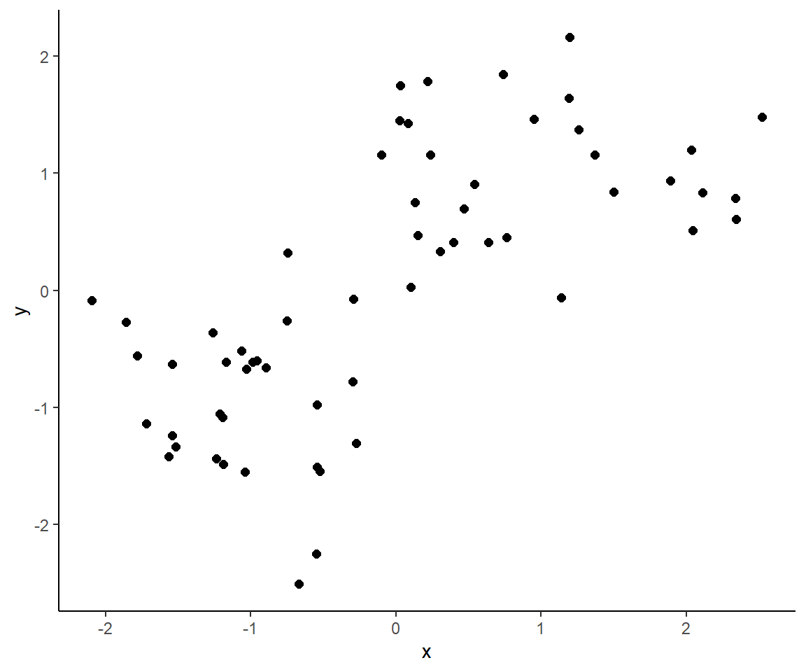

Slide 11
K-means clustering
Choose K and then...
Randomly assign a number, from 1 to K, to each of the observations. (These serve as initial cluster assignments for the observations).
Iterate until the cluster assignments stop changing.
For each of the K clusters, computer the cluster centroid. The kth cluster centroid is the vector of the p covariate means for the observations in the kth cluster.
Assign each observation to the cluster whose centroid is closest (where closest is deemed using Euclidean distance).

Slide 12
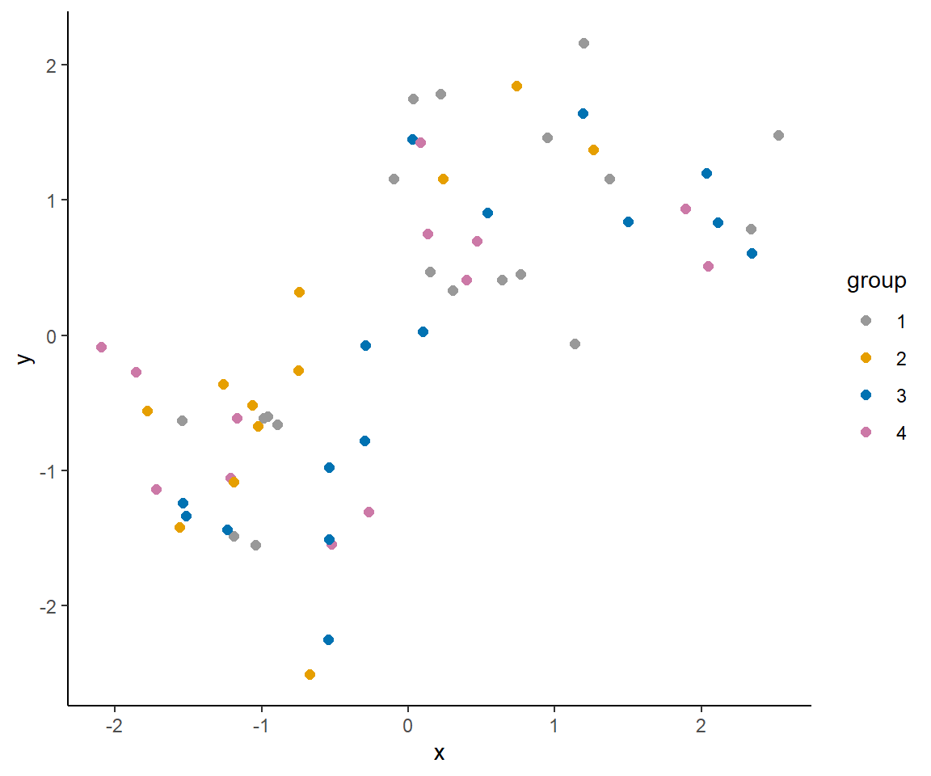

Slide 13
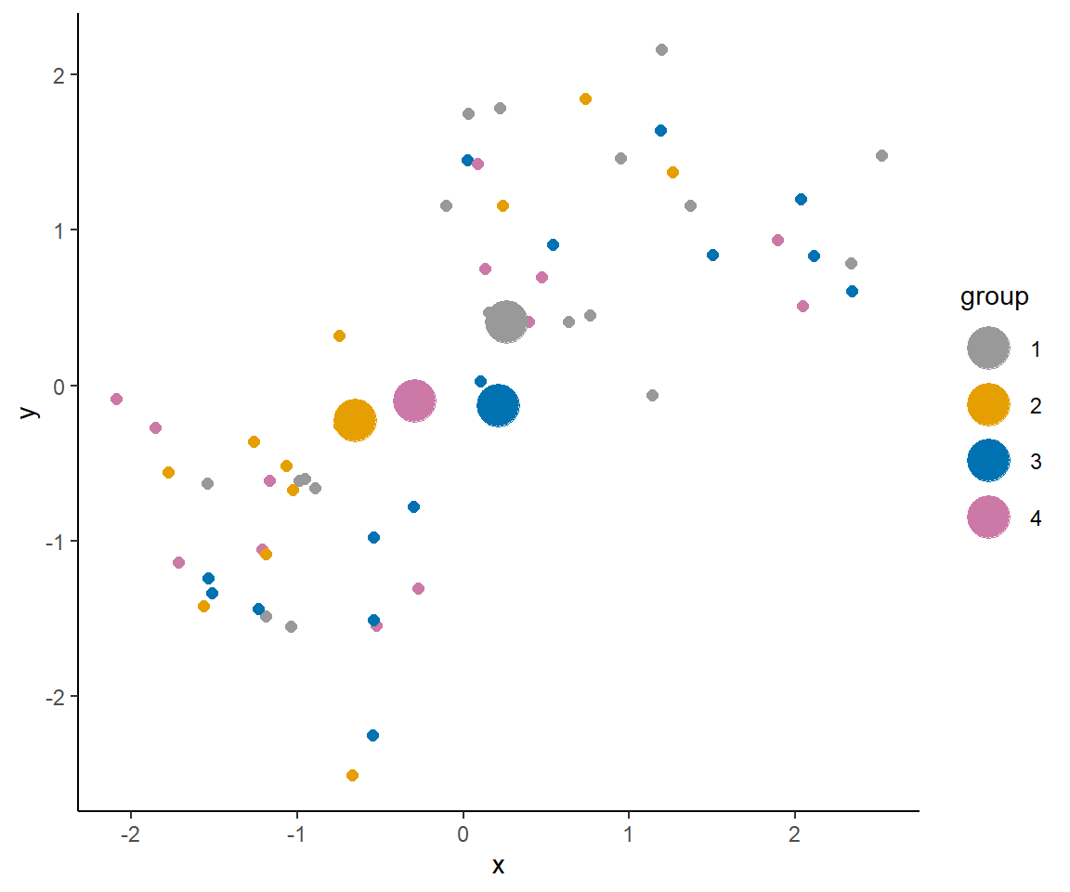

Slide 14
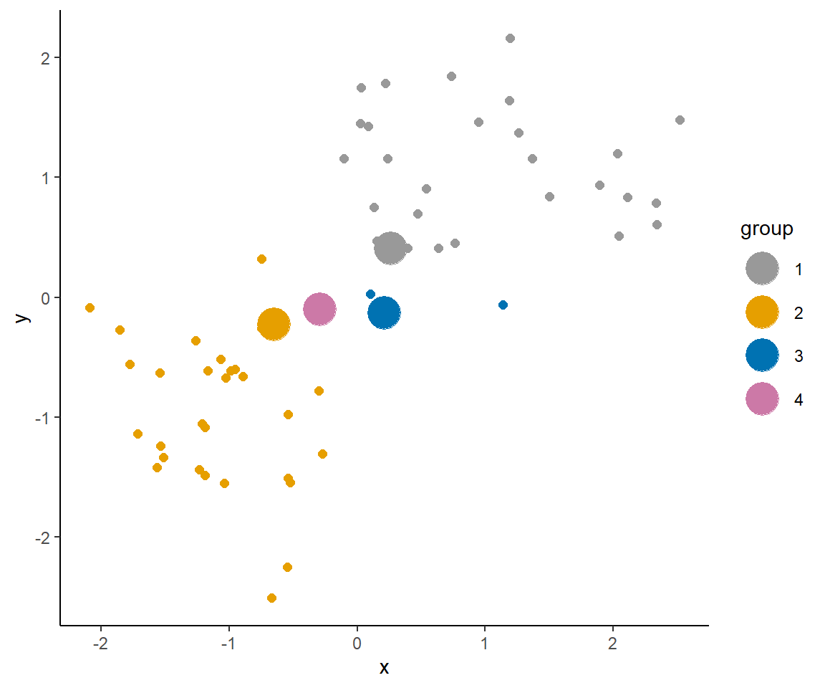

Slide 15
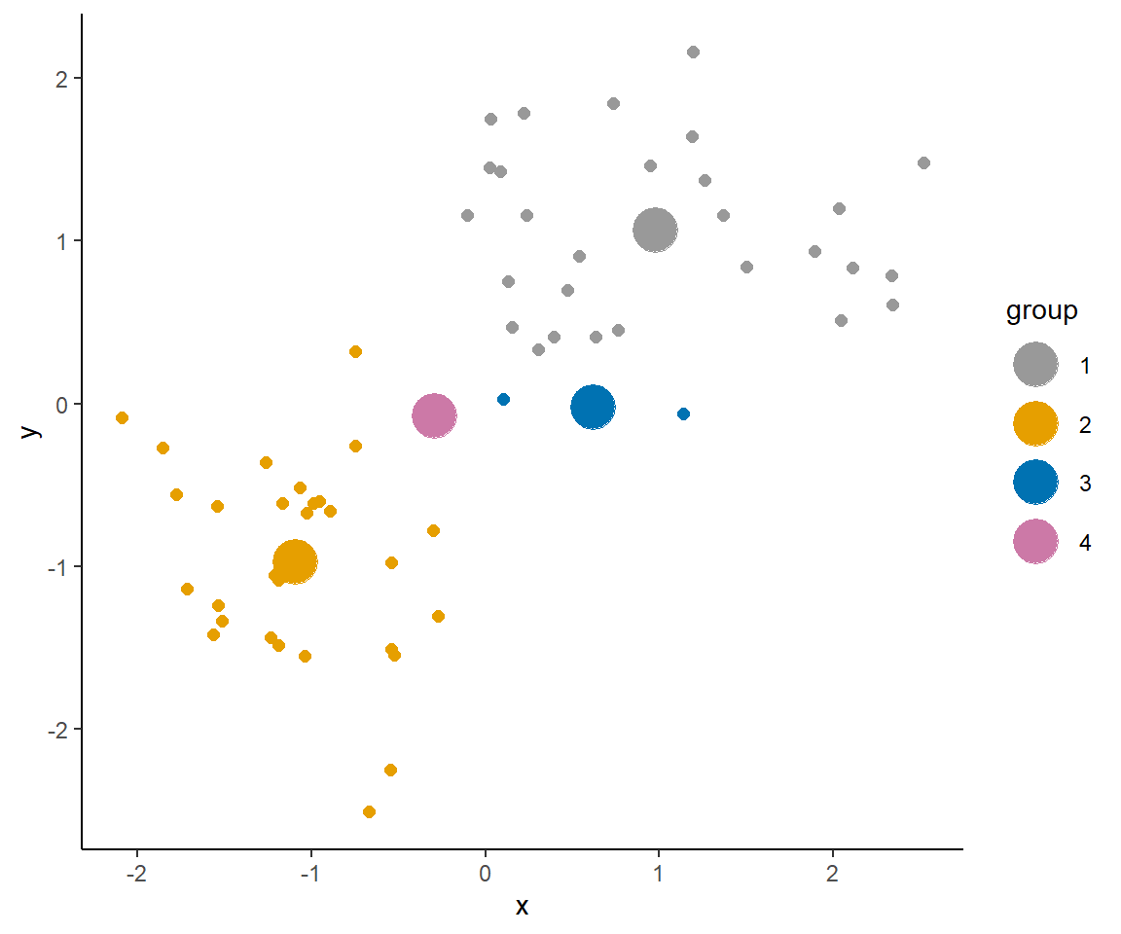

Slide 16


Slide 17
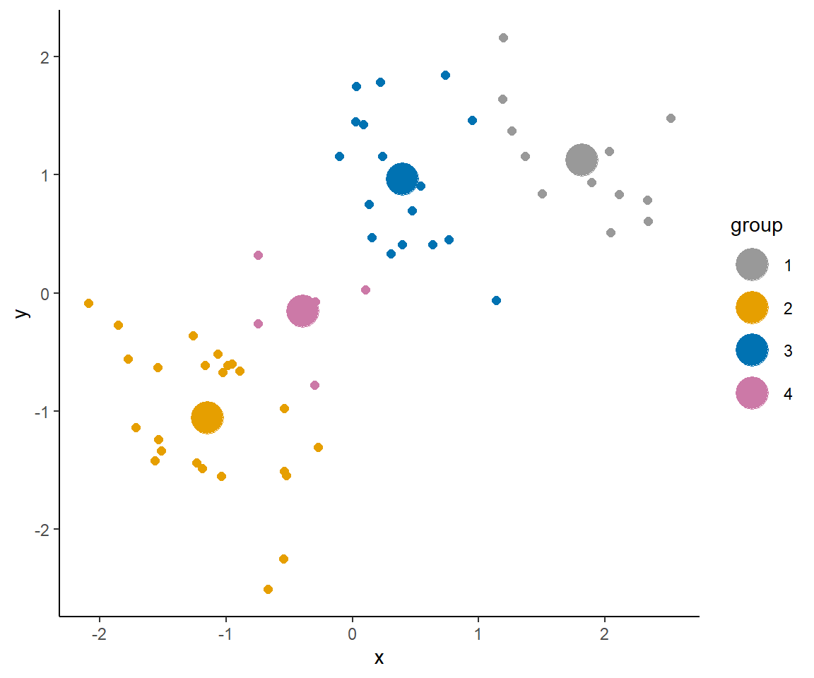

Slide 18
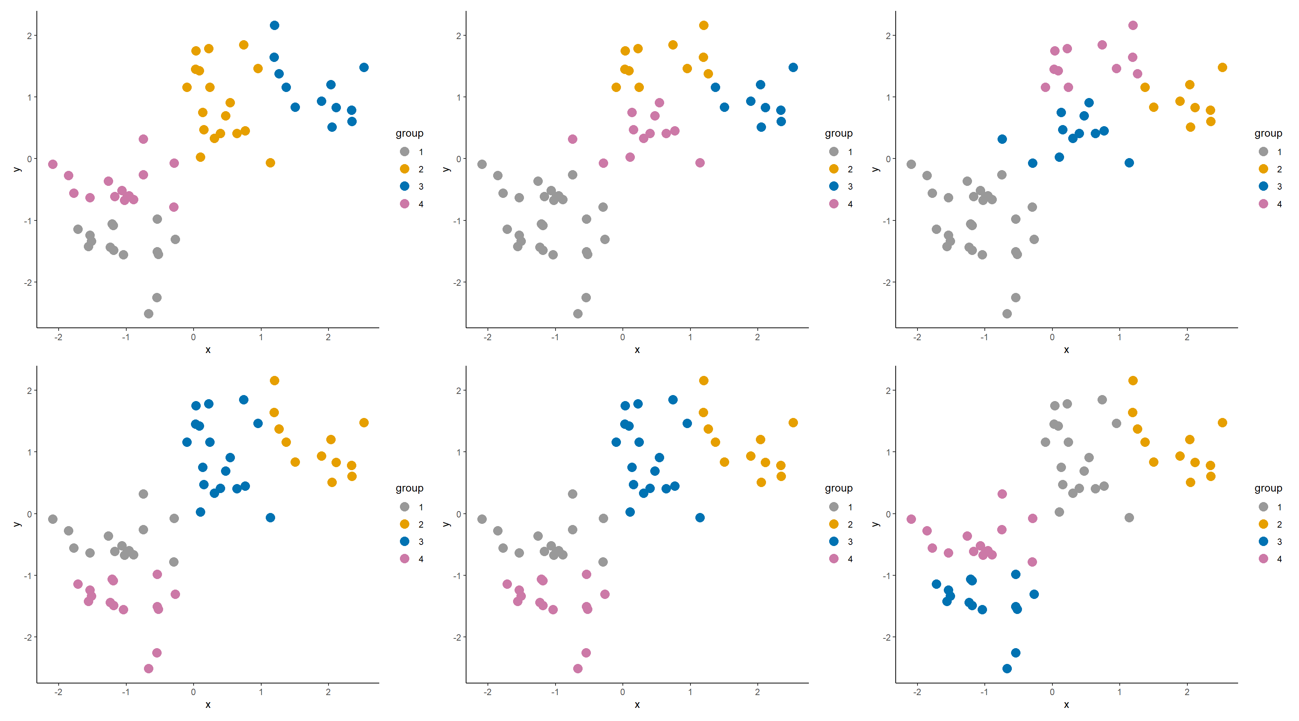

Slide 19
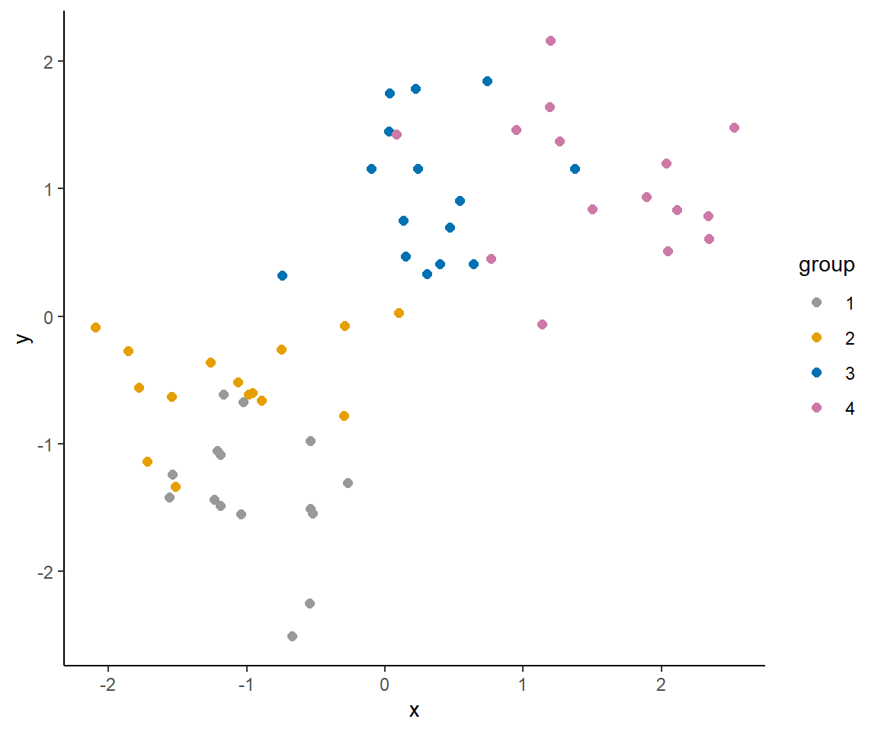

Slide 20
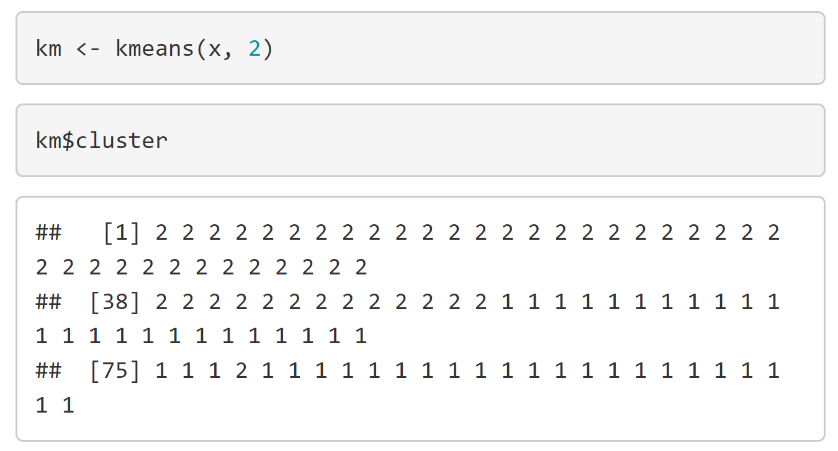
Code

Slide 21
Hierarchical clustering

Slide 22
Hierarchical clustering
Hierarchical clustering methods produce a tree or dendrogram.
They avoid specifying how many clusters are appropriate by providing a partition for each k obtained from cutting the tree at some level.
The tree can be built in two distinct ways
1. bottom-up: agglomerative clustering.
2. top-down: divisive clustering.

Slide 23
Alizadeh, Ash A., et al. "Distinct types of diffuse large B-cell lymphoma identified by gene expression profiling." Nature 403.6769 (2000): 503.

Slide 24
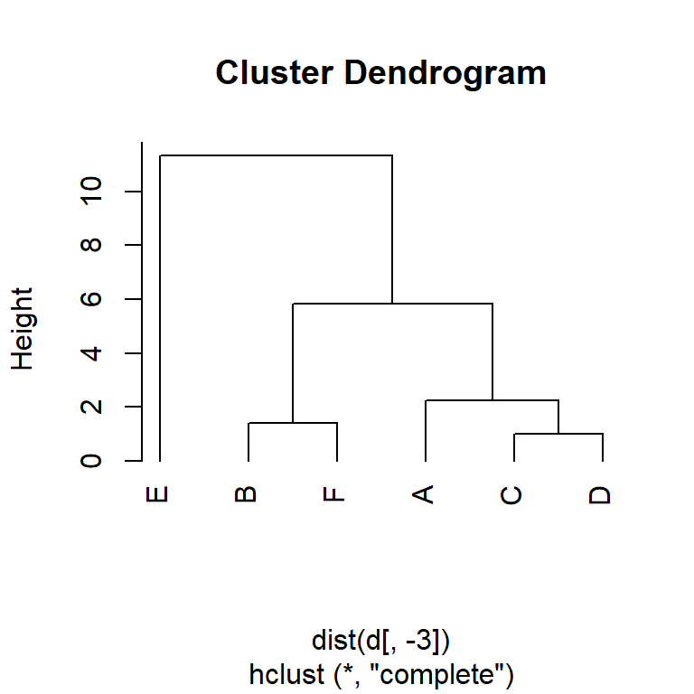
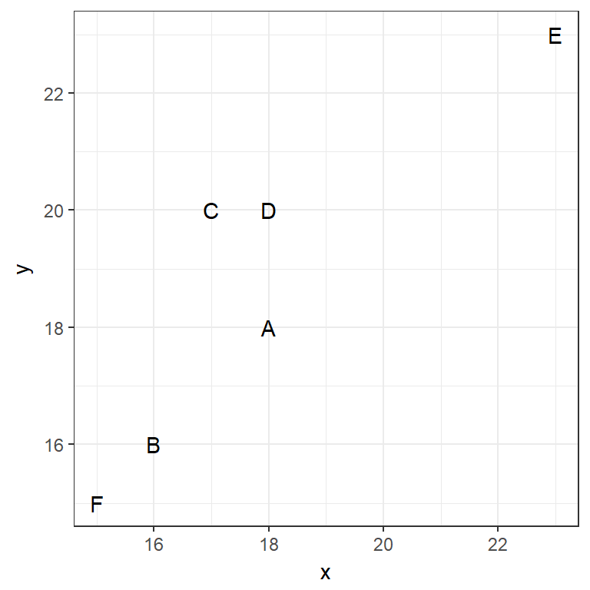
Example 1

Slide 25
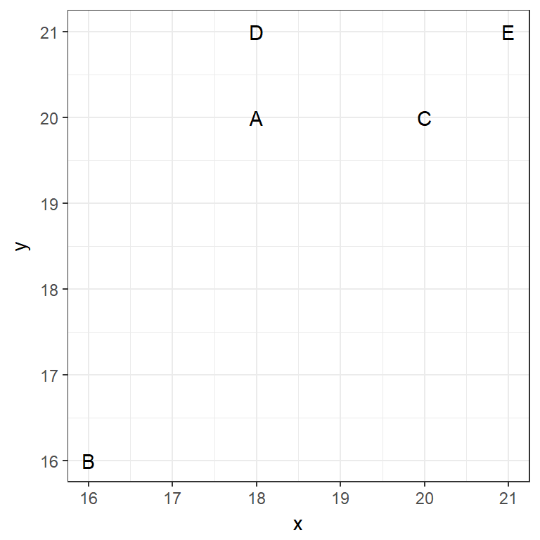
Example 2
(cm)
(mm)

Slide 26
Between cluster similarity measures

Slide 27
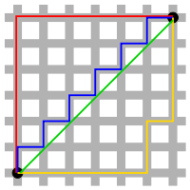
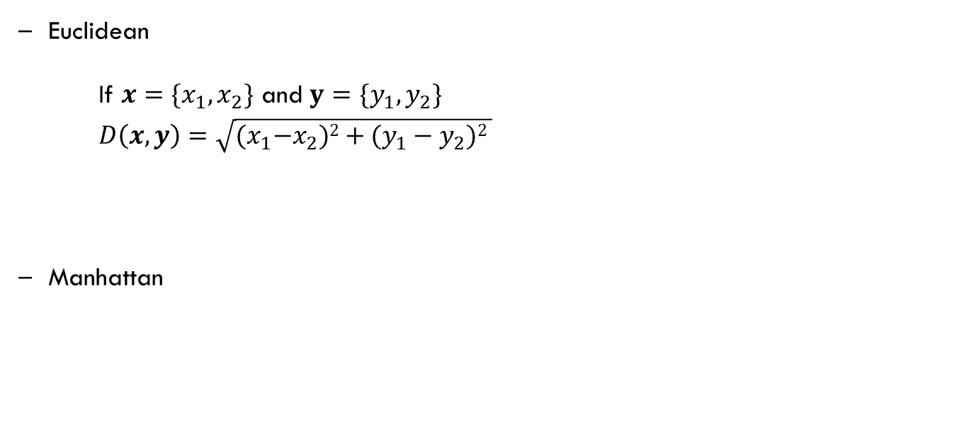
Distance metrics
Euclidean
If $x=\{x_{1}, x_{2}\}$ and $y=\{y_{1}, y_{2}\}$
$D\left(x,y\right)=\sqrt{{(x}_{1}−x_{2})2+(y_{1}−y_{2})2 }$
Manhattan
Green = 8.49
Red, blue, yellow = 12

Slide 28
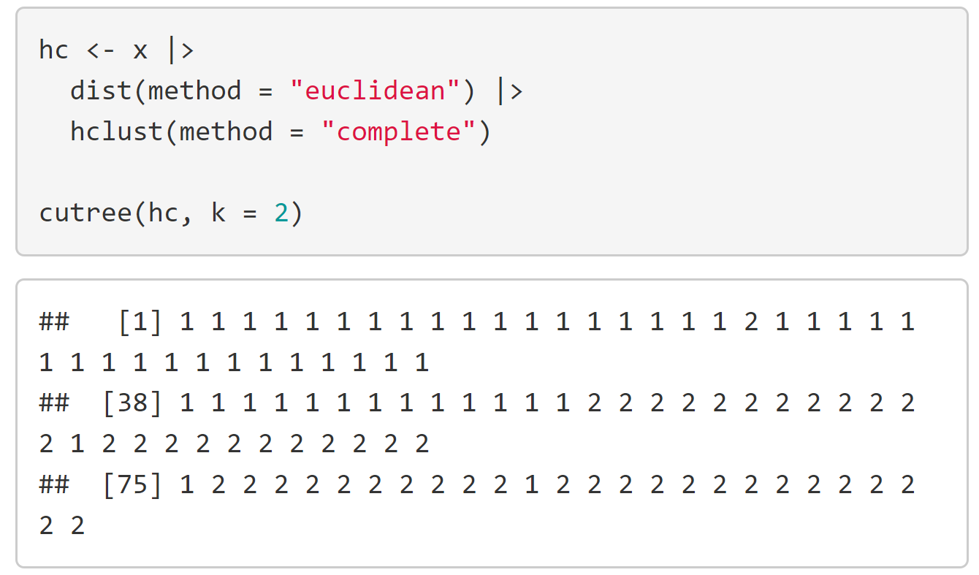
Code

Slide 29
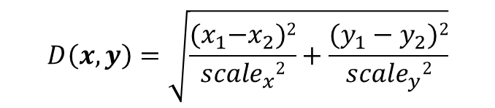
$$D\left(x,y\right)=\sqrt{\frac{{(x}_{1}−x_{2})2}{{scale}_{x}2}+\frac{(y_{1}−y_{2})2}{{scale}_{y}2}}$$
(cm)
(mm)

Slide 30
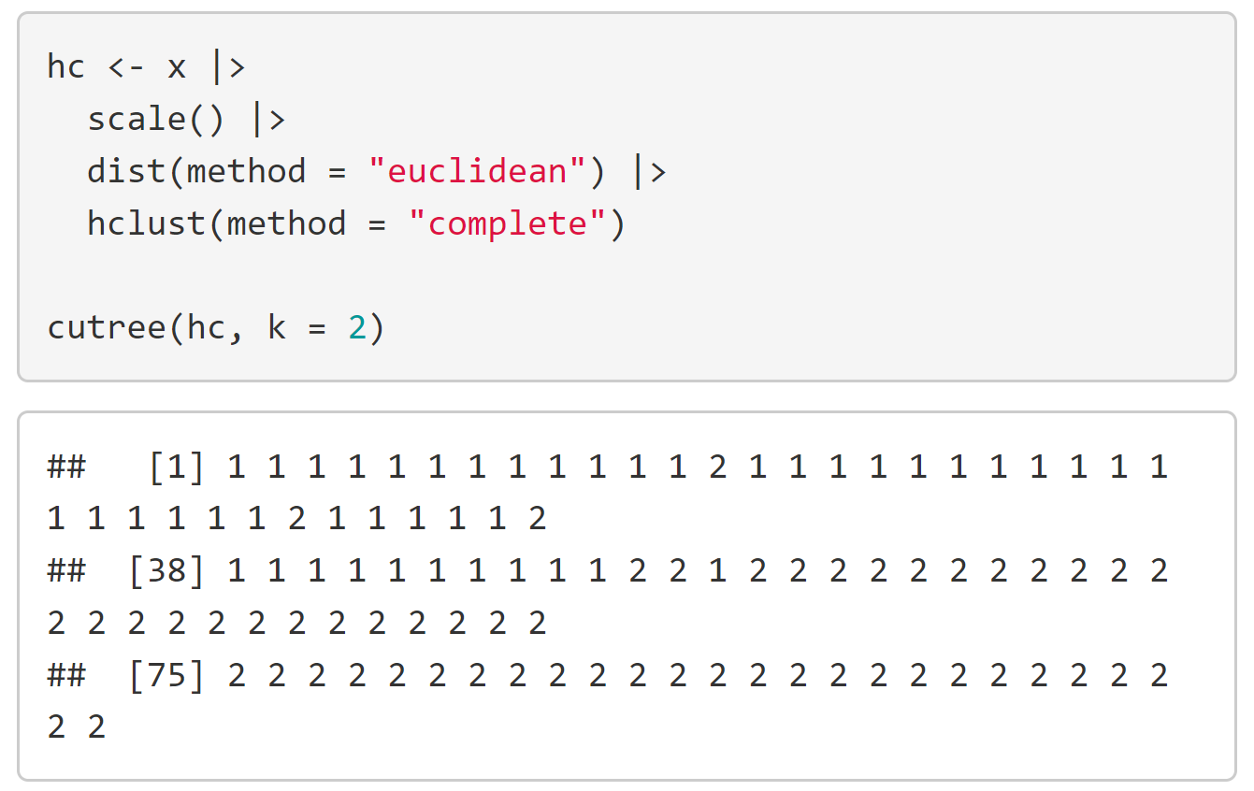
Code

Slide 31
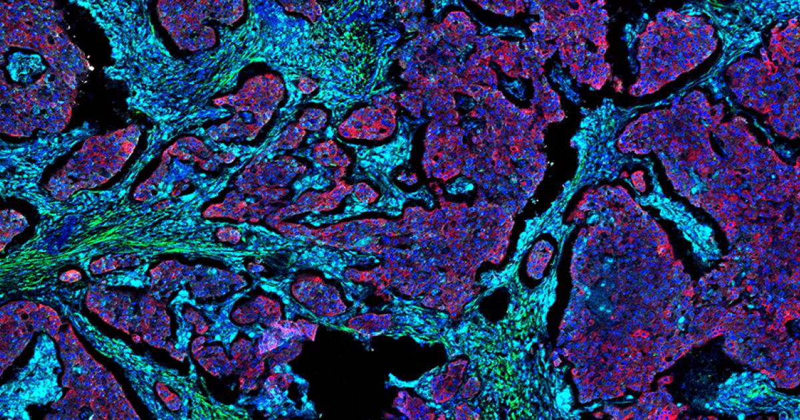
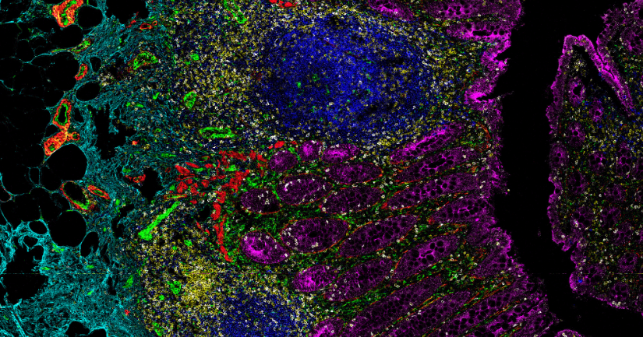
Highly multiplexed in situ imaging cytometry

Slide 32
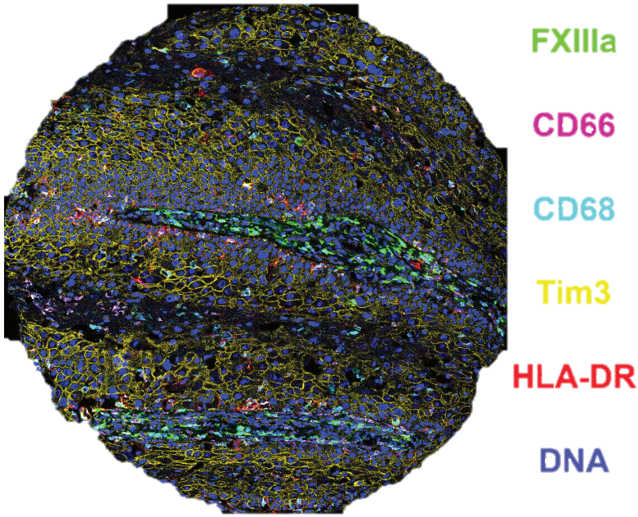

Slide 33

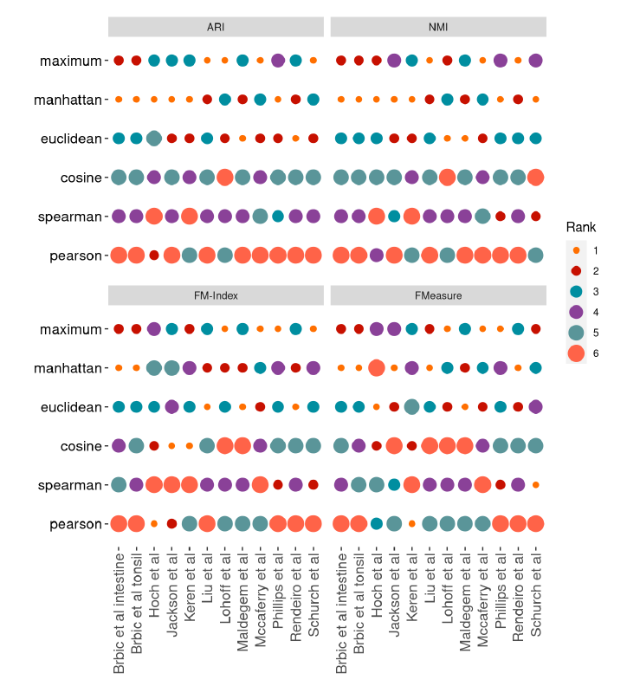
Clustering highly multiplexed imaging data

Slide 34
When and why?

Slide 35
When and why?
Some advantages of hierarchical clustering:
1. Don't need to know how many clusters you're after.
2. Can cut hierarchy at any level to get any number of clusters.
3. Easy to interpret hierarchy for particular applications.
4. Deterministic.
Some advantages of k-means clustering:
1. Can be much faster than hierarchical clustering, depending on data.
2. Nice theoretical framework.
3. Can incorporate new data and reform clusters easily.

Slide 36
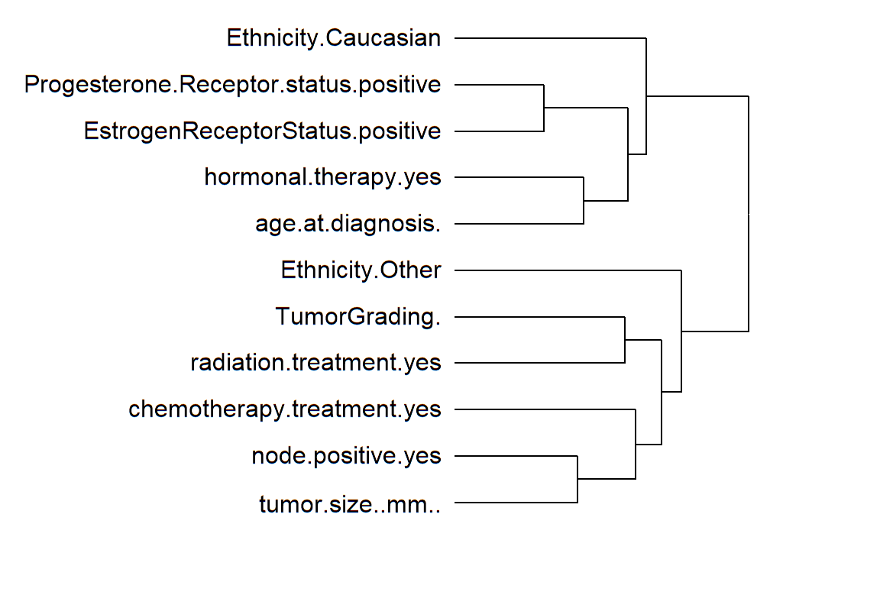
Quantitative clustering

Slide 37
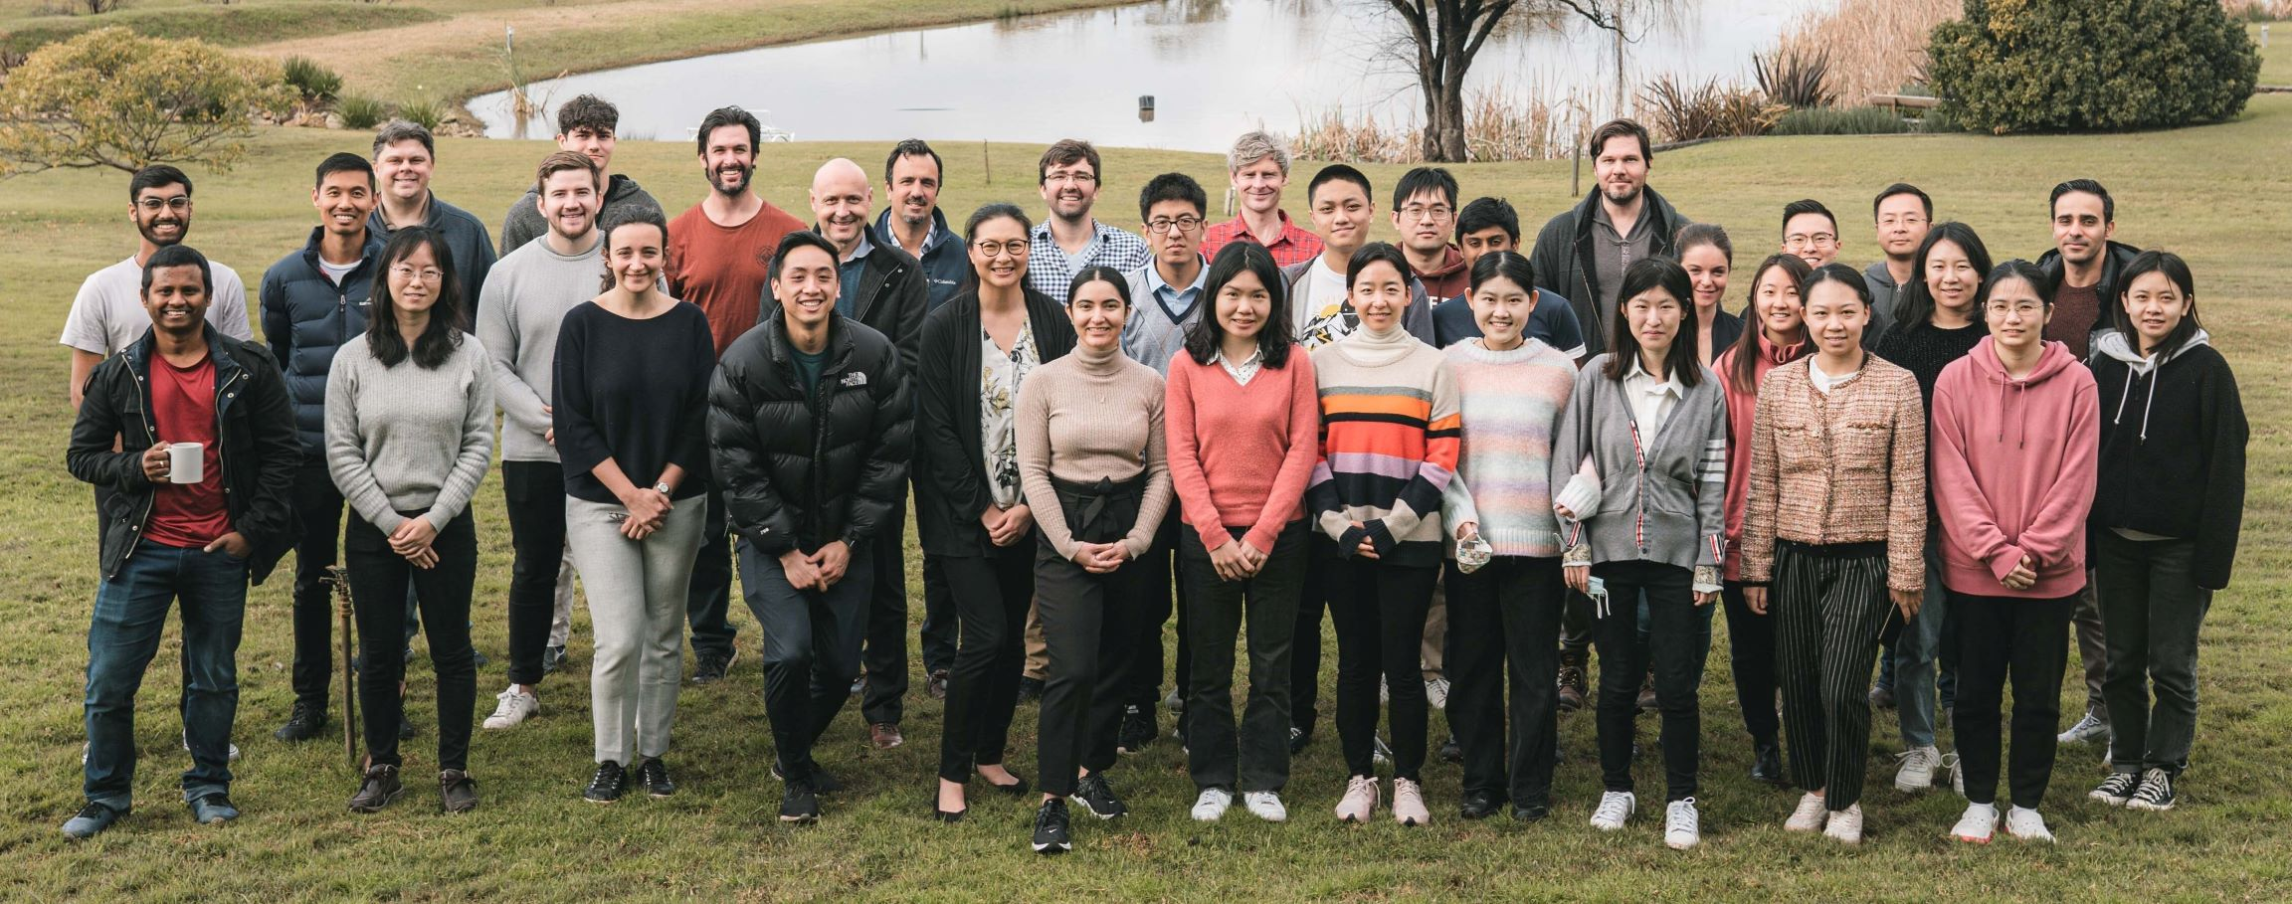
Sydney Precision Data Science Centre Precision Bioinformatics Cluster
We share an interest in developing statistical and computational methodologies to tackle the foremost significant challenges posed by modern biology and medicine.
Find out more: http://www.maths.usyd.edu.au/bioinformatics/
Shiny apps: http://shiny.maths.usyd.edu.au/
Github: https://github.com/SydneyBioX

Slide 38
Thanks!

